Slide 1
Chapter 7: The Road to Revolution
1763-1775

Slide 2
The Deep Roots of Revolution
How were the British colonies treated up to this point?
Colonists develop an idea of republicanism, which strongly opposes a monarch.
An idea from Britain makes its way to the colonies.
Radical Whigs, a group that opposed the king, due to the patronage and “corruption.”

Slide 3
Mercantilism and Colonial Grievances
Mercantilism: colonies send Britain raw materials and Britain sends back finished products
Who is getting the bigger benefit?

Slide 4
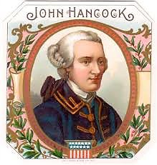
The Merits and Menace of Mercantilism
Why no problems before? Salutary Neglect. The British before this time didn’t enforce many of the laws.
The colonist also were able to do very well, a monopoly on tobacco, good prices for ship parts from New England, and smuggling.

Slide 5
The Stamp Tax Uproar
French and Indian War = huge debt for Britain!
Who should pay? The colonists, after all the debt was from “protecting” them.
Mnemonic device: “S A (Q) D T W I T S”
1) Sugar Act of 1764
First tax where main goal was to raise revenue by regulating trade
The colonists are outraged!
“Taxation without representation.”
British lower the taxes and say the colonists are virtually represented.
Was direct representation even possible? Would it have even helped the colonists?

Slide 6
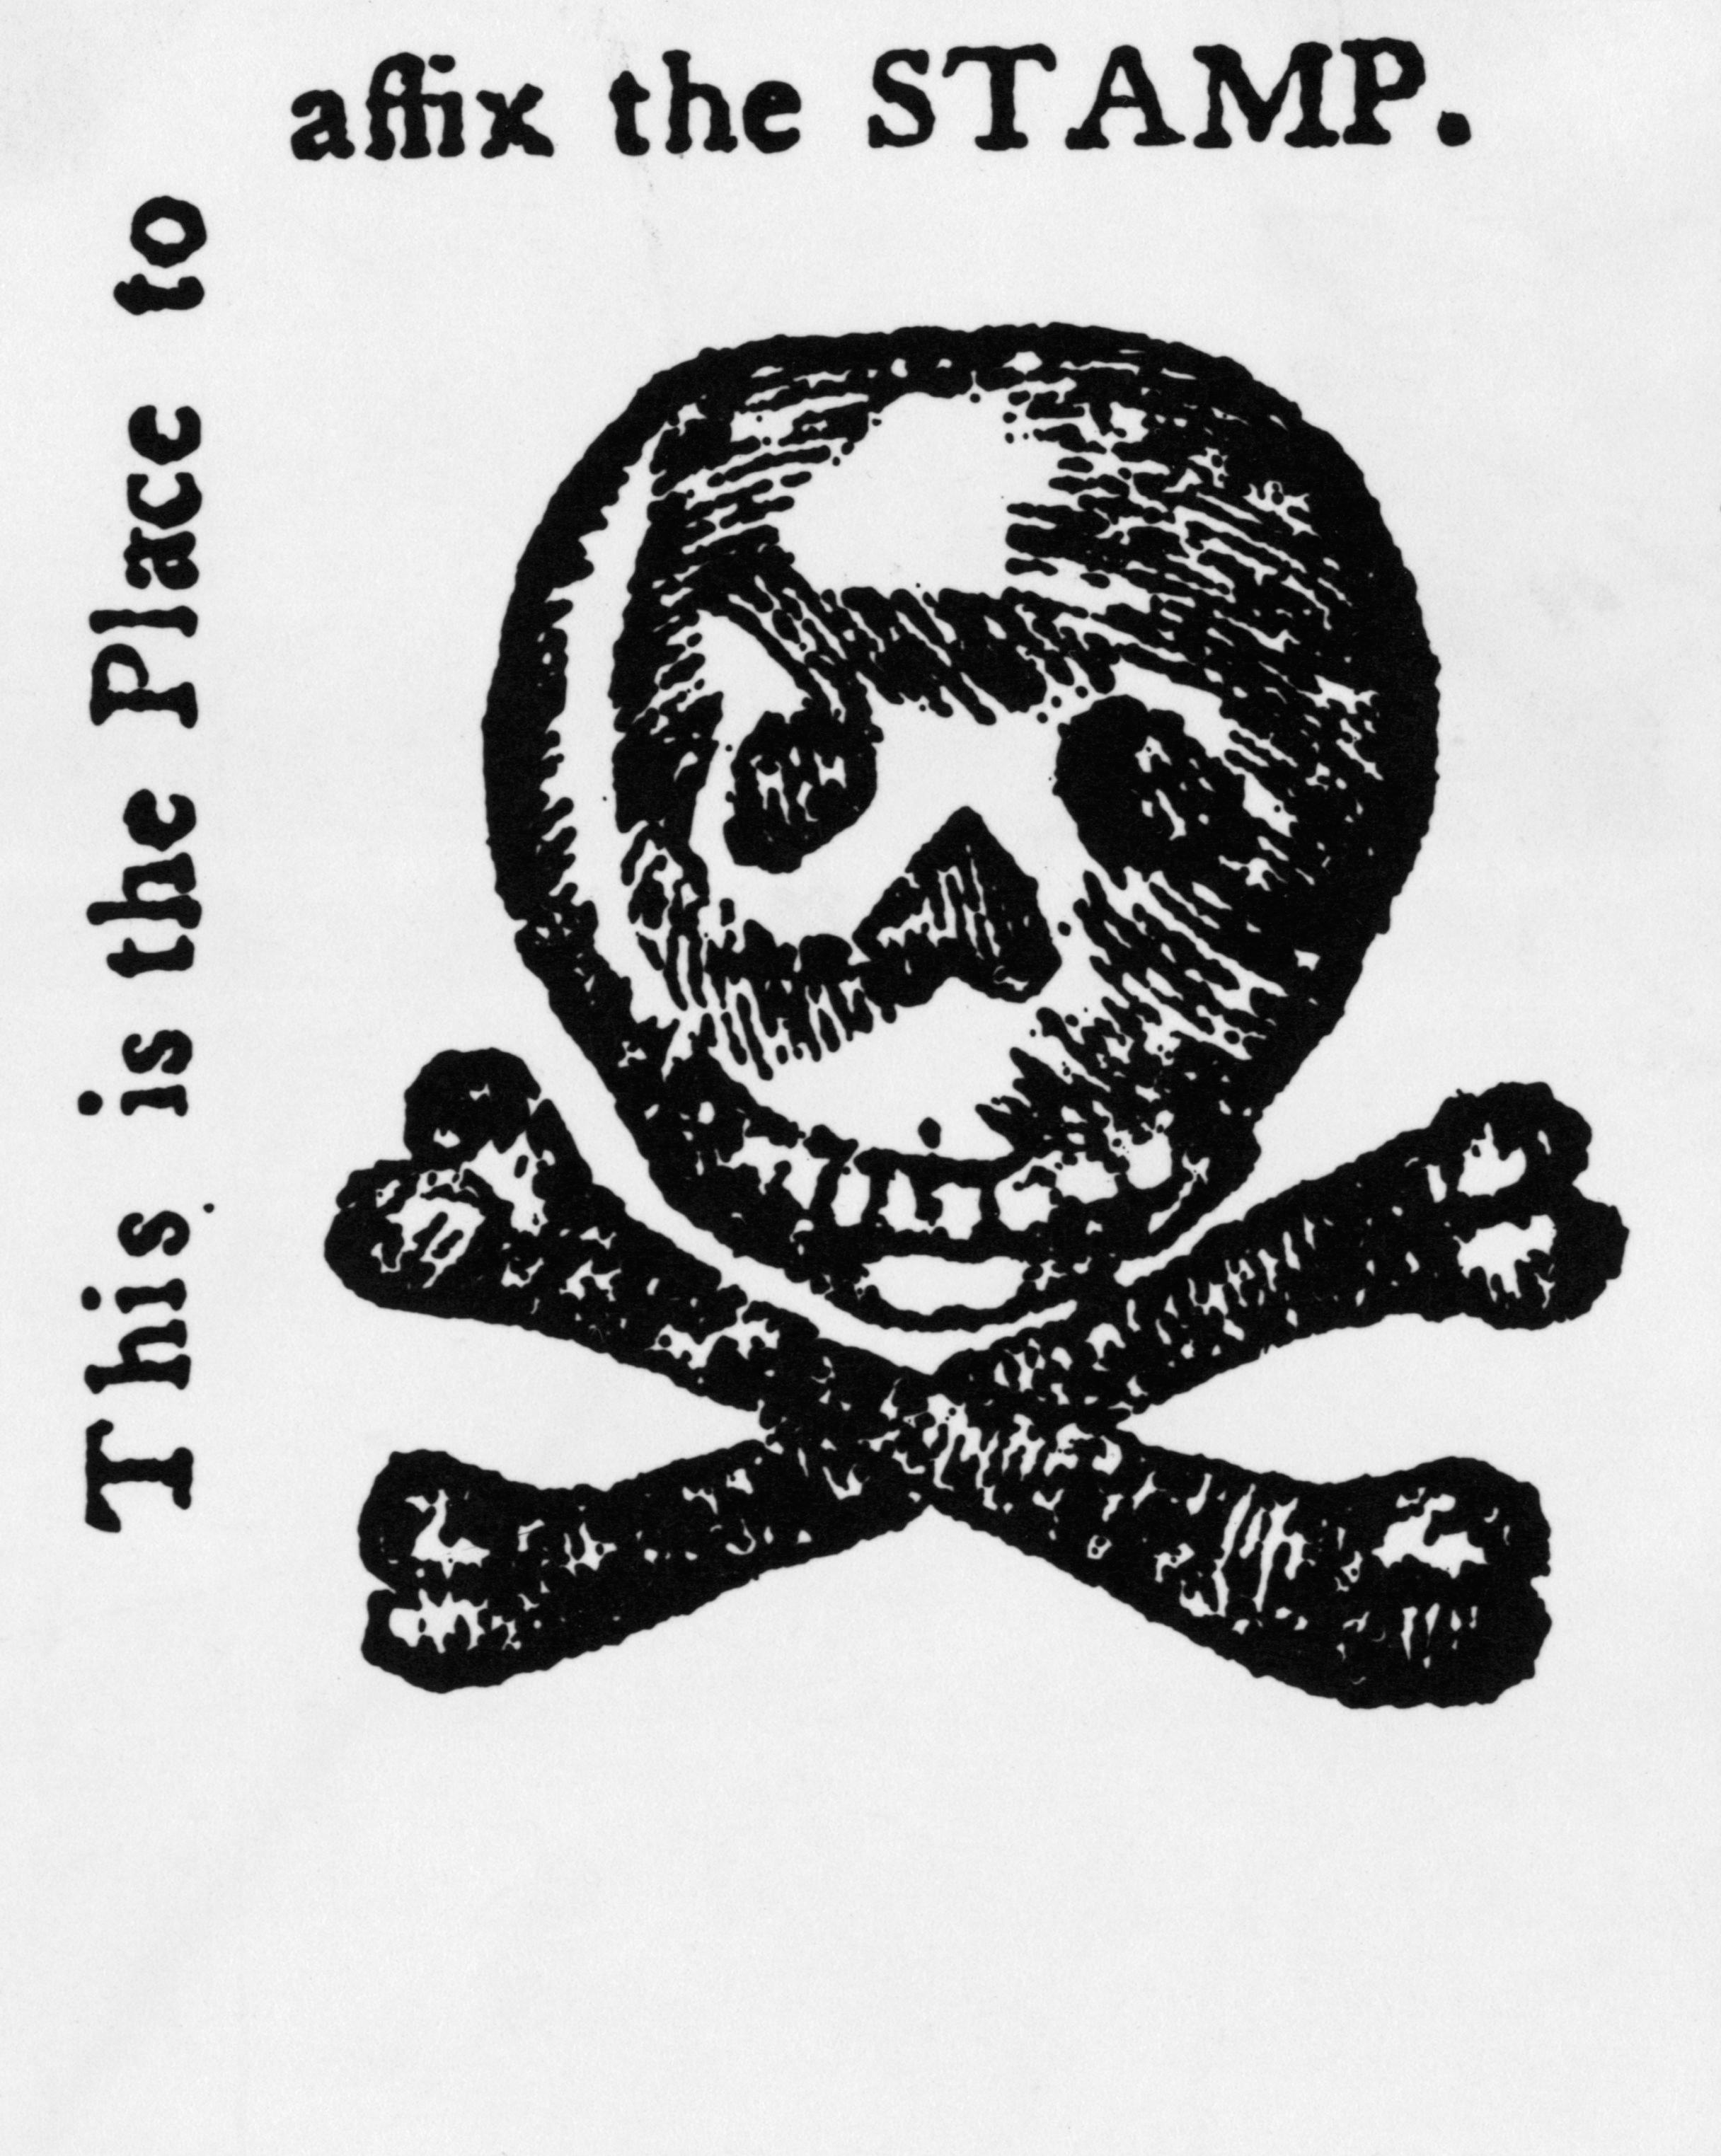
The Stamp Tax Uproar contd.
Quartering Act: certain colonies had to provide food and quarters for British troops. (see 3rd Amendment)
Stamp Act: Requires a stamp on 50 common goods
Ex: newspapers pamphlets, marriage licenses, playing cards, etc.
Raise revenue directly from colonists for crown
2) Admiralty courts: violators of these laws would be tried where there were no juries, and you were guilty unless proven innocent.

Slide 7
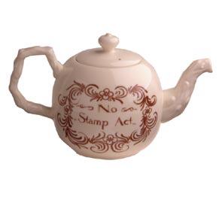
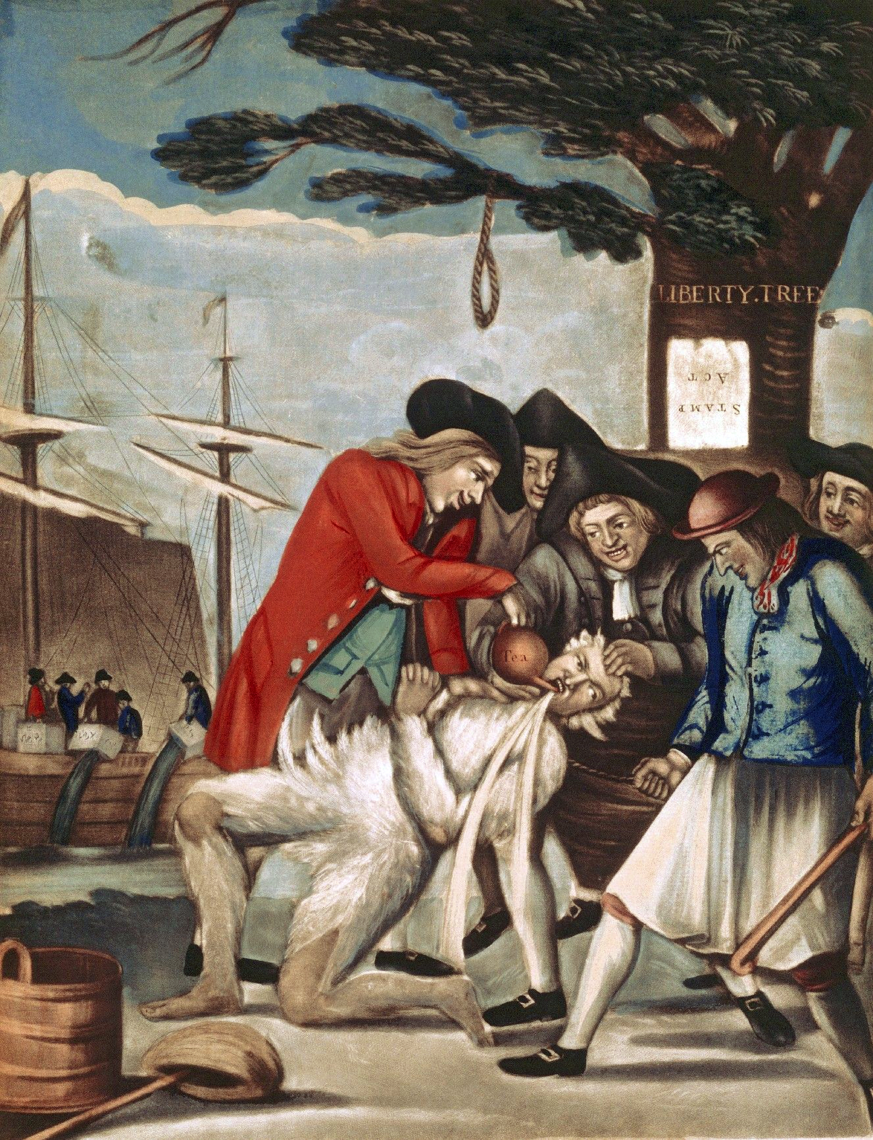
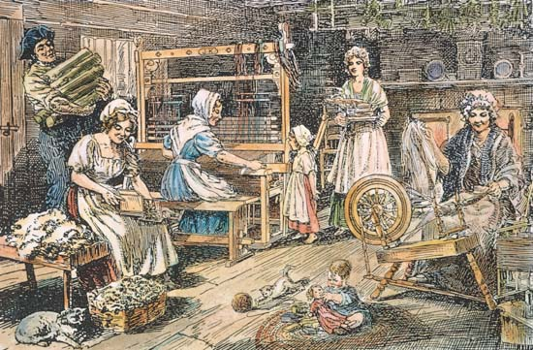
Forced Repeal of the Stamp Act
Stamp Act Congress 1765: first attempt at colonial unity against British.
NYC-27 delegates from 9 colonies.
Result= Declaration of Rights and Grievances
Nonimportation agreement: New York and Boston boycott British manufactured goods, and begin the “homespun” movement.
Sons and Daughters of Liberty: Secret radical groups that used violence to protest the British taxes. Mostly NYC and Boston, major leader Sam Adams.
The British repeal the Stamp Act in 1766, but also pass…
3) Declaratory Act: Parliament has the right and power to make laws that were binding on the colonies “in all cases whatsoever” - this includes new taxes.

Slide 8
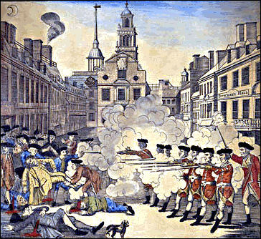
The Townshend Tea Tax and Boston “Massacre”
4) Townshend Acts: Taxes on imports; glass, tea, etc.
Again, raises revenue via trade (like the Sugar Act!)
Result =
5) Writs of Assistance: a written order issued by a court instructing an official to perform a certain task
Tax money earmarked to pay the salaries of royal governors.
Boston Massacre March 5th, 1770: British troops sent to restore order, taunted by a large mob, the troops opened fire and killed or wounded 11 people.
Future president John Adams would represent the British troops.
Paul Revere’s engraving used as pro-colonial propaganda.

Slide 9
The Seditious Committees of Correspondence
The Townshend duties are repealed except for the tax on tea!
Committees of Correspondence: Patriots organized to exchange information about British action in the colonies.
Helps persuade public opinion of the colonists.
Spread the spirit of resistance via letters (post office).
Result = Leads to colonial congresses similar to House of Burgesses (VA – 1619).

Slide 10
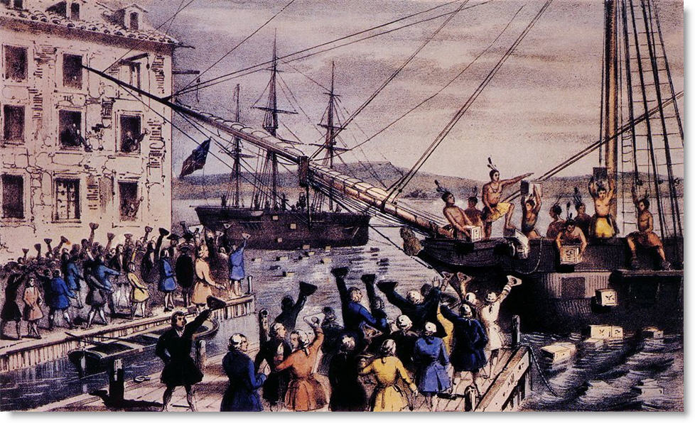
Tea Brewing in Boston
Tea was actually cheaper in the colonies than in Britain!
6) Tea Act: Designed to help struggling British East India Company.
Result = a monopoly to sell tea to the colonies, which cuts out American merchants.
Boston Tea Party: a group of angry Bostonians, threw 342 chests of tea into the Atlantic.

Slide 11
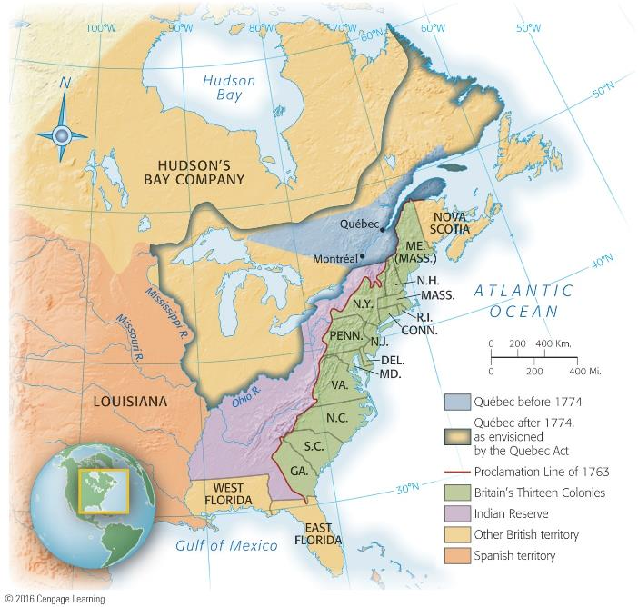
Parliament passes the “Intolerable Acts”
7) Intolerable acts: series of acts set to punish the colonists (specifically Massachusetts).
Closed the port of Boston until damages were paid and order was restored.
Quartering act said British soldiers could be lodged in private homes.
Enforcing officials who killed colonists would be sent to Britain for trial.
Quebec Act (NOT actually a part of the intolerable acts, but passed at the same time, 1774)
Gives western territory north of the Ohio River to Quebec (some colonists are already living in this region).
Allows French to keep many of their same customs including no trial by jury, or representative assembly.
Result = Colonists saw this as what could happen to them.

Slide 12
Bloodshed
Lead to the First Continental Congress in 1774.
Delegates from 12 or the 13 colonies (Georgia excluded it is truly a crown-founded colony).
Results in…
adoption of Declaration of Rights and Grievances
creation of The Association calling for complete boycott
NO independence, wanted simply to return to the way things were, before taxation.
If King George did not address these grievances, the congress would meet again in 1775.
The grievances are ignored by King George
Colonists begin to stockpile munitions and drill openly

Slide 13
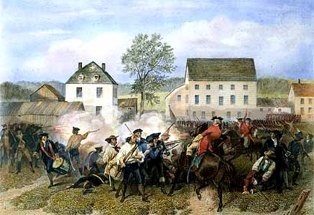
Bloodshed contd
Lexington and Concord April 1775:
British troops sent to seize stores of colonial munitions
Met with American resistance
Fighting ensues at Lexington (Paul Revere – 1 if by land, 2 if by sea), troops continued to Concord where they were forced to retreat (“Shot heard round the world”).

Slide 14
Imperial (British) Strength and Weakness
Strength
Weakness
Population 7.5 vs. 2.5 million
$$
Naval power
Ability to hire foreign soldiers (German Hessians)
American Loyalists
Native Americans
Issues in Ireland
The French waiting to get back at the British (F & I War)
American sympathizers in Britain (Whigs)
Needed complete victory
Far from “home”
America is very large
No single capital to capture

Slide 15
Colonist (“American”) Pluses and Minuses
Pluses
Minuses
Leadership (GW, Franklin)
Foreign Aid (M. de Lafayette)
Agriculture
Fighting Defensively
Knowledge of the terrain
Poor Organization/Unity
Jealousy
Economic difficulties
Print paper money to the point of hyper inflation

Slide 16
A Thin line of Heroes
War materials were in short supply
Women were left to tend farms while the men were off fighting, and many followed the American Army.
Many African Americans served on both sides during the American Revolution.

